Slide 1
Proposal for HOOF Information System
Specter Designs

Slide 2
Agenda
Problem areas
Improvements
Windows Navigation Diagram
Prototypes
Conclusion

Slide 3
Problem Area
Lack of an online presence, limiting company awareness
Lack of online donation options for users, limiting the ways they can give.
Lack of central information source, increasing information gathering time

Slide 4
Problem Areas Improvement
We want to create a centralized database where all the company data may be stored and accessed
We Believe we can improve donation revenue through expanding online options.
We see ways to facilitate improvement in the grant writing process

Slide 5
Prototypes
Objective: To present prototypes bases off of the Windows Navigation Diagram
Various Prototypes represent several portals based upon the type of user:
Donor
Volunteer
Board Member

Slide 6
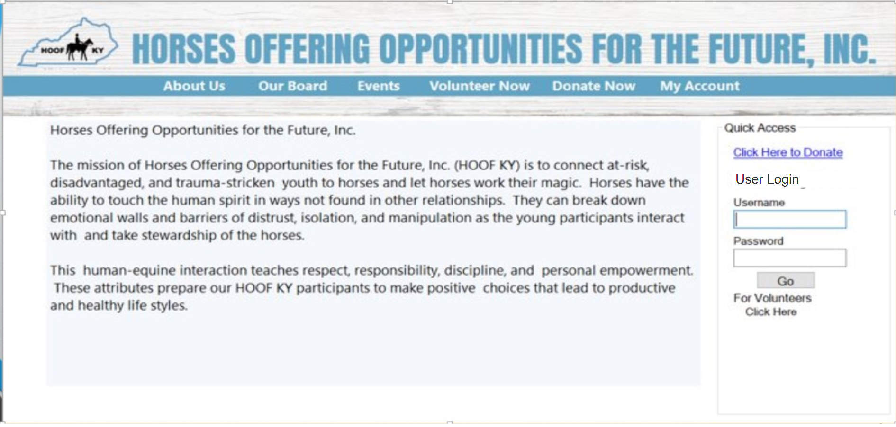
Donor Login

Slide 7
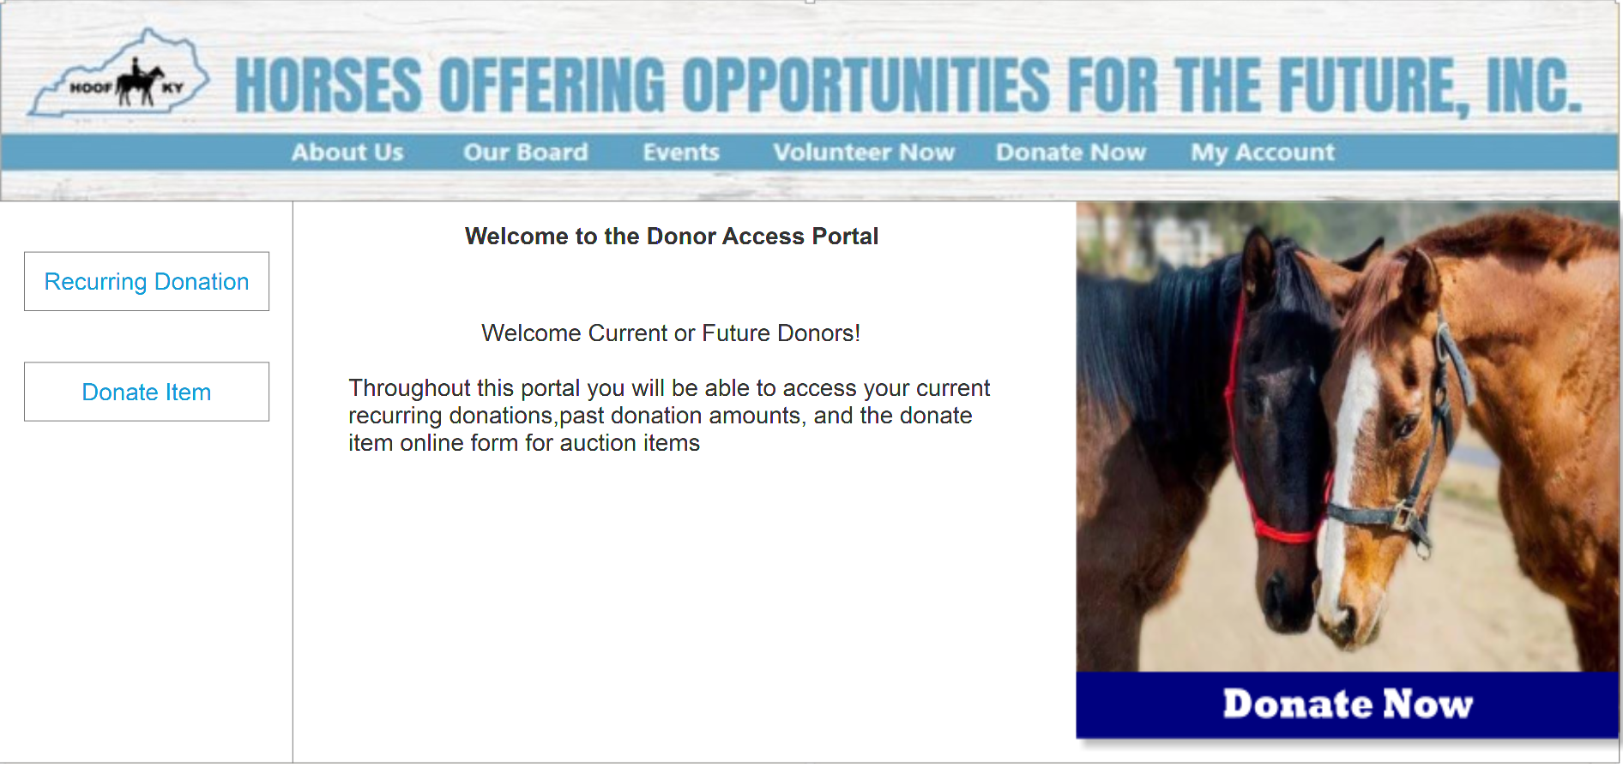
Donor Portal

Slide 8
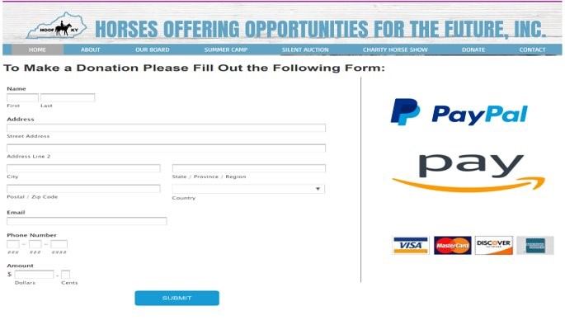
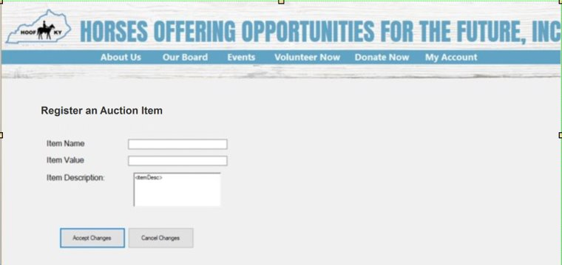
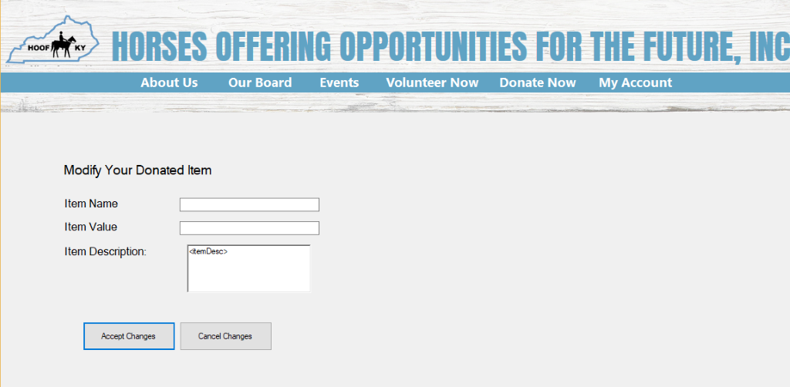
Examples of Past Donor Prototypes

Slide 9
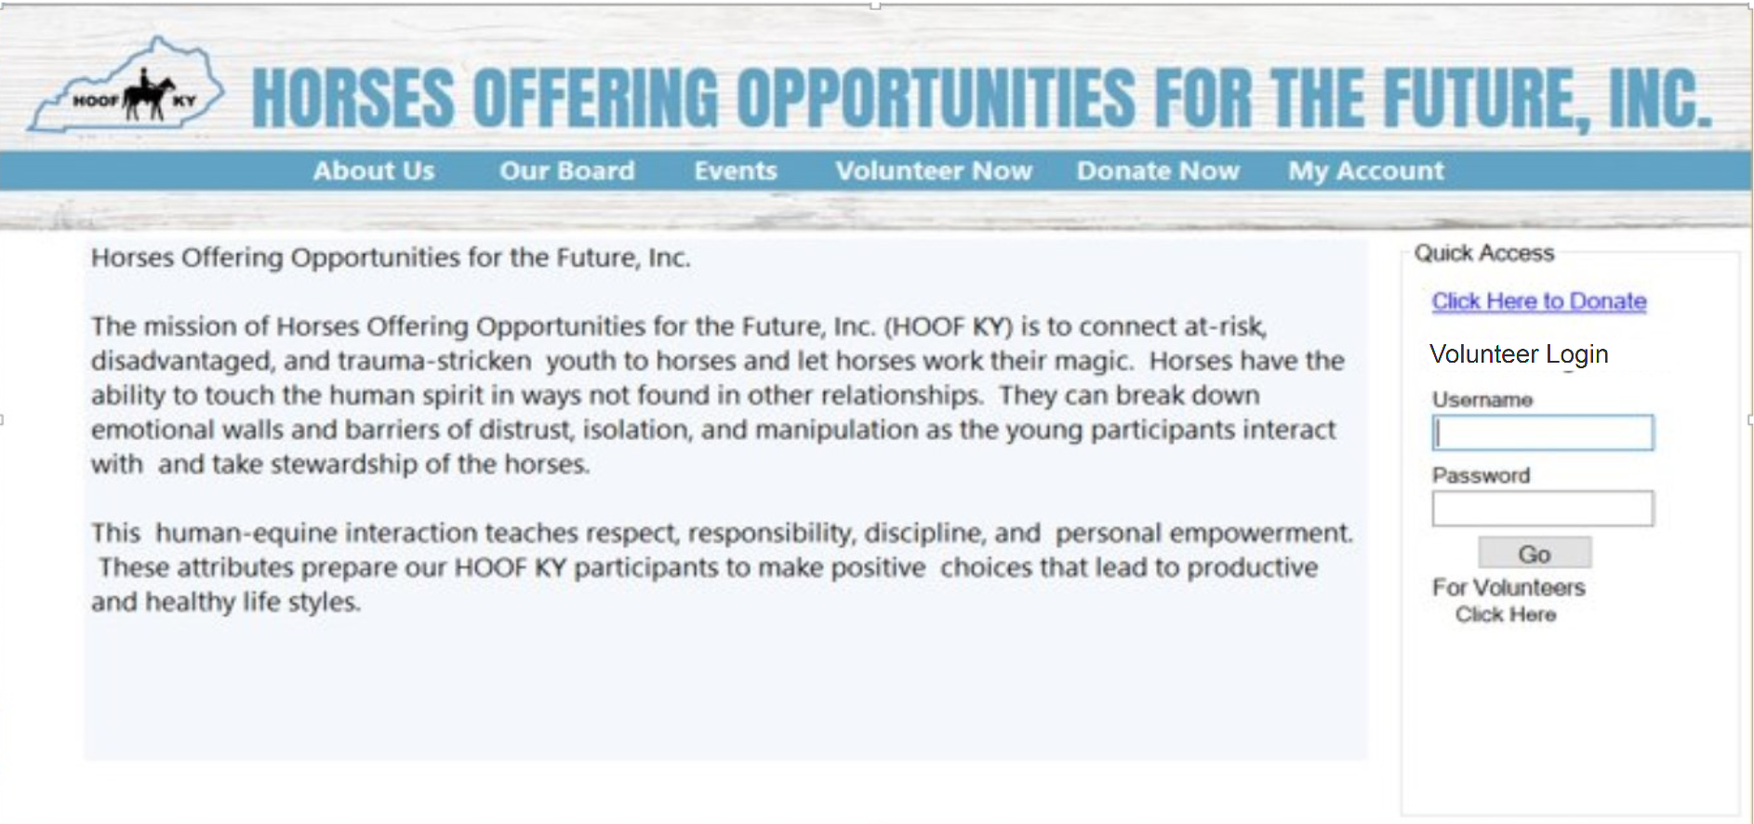
Volunteer Login

Slide 10
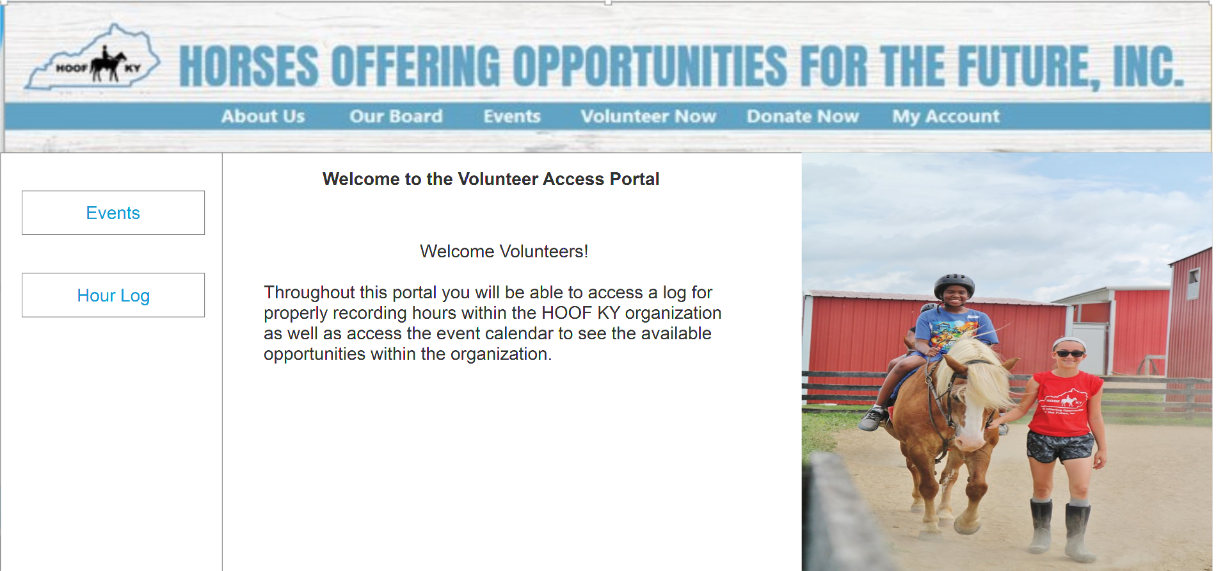
Volunteer Portal

Slide 11
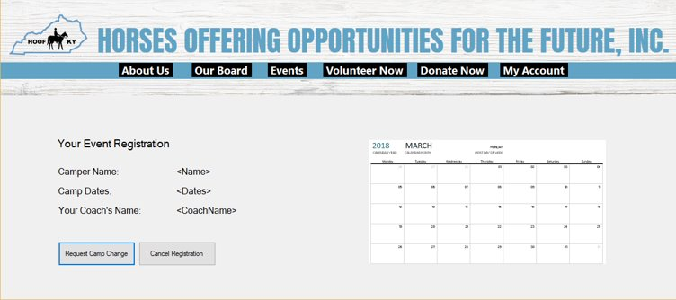
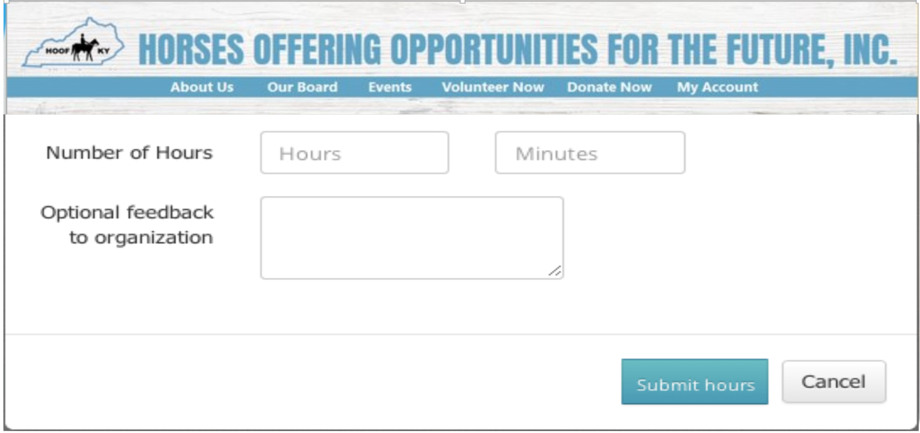
Examples of Past Volunteer Prototypes

Slide 12
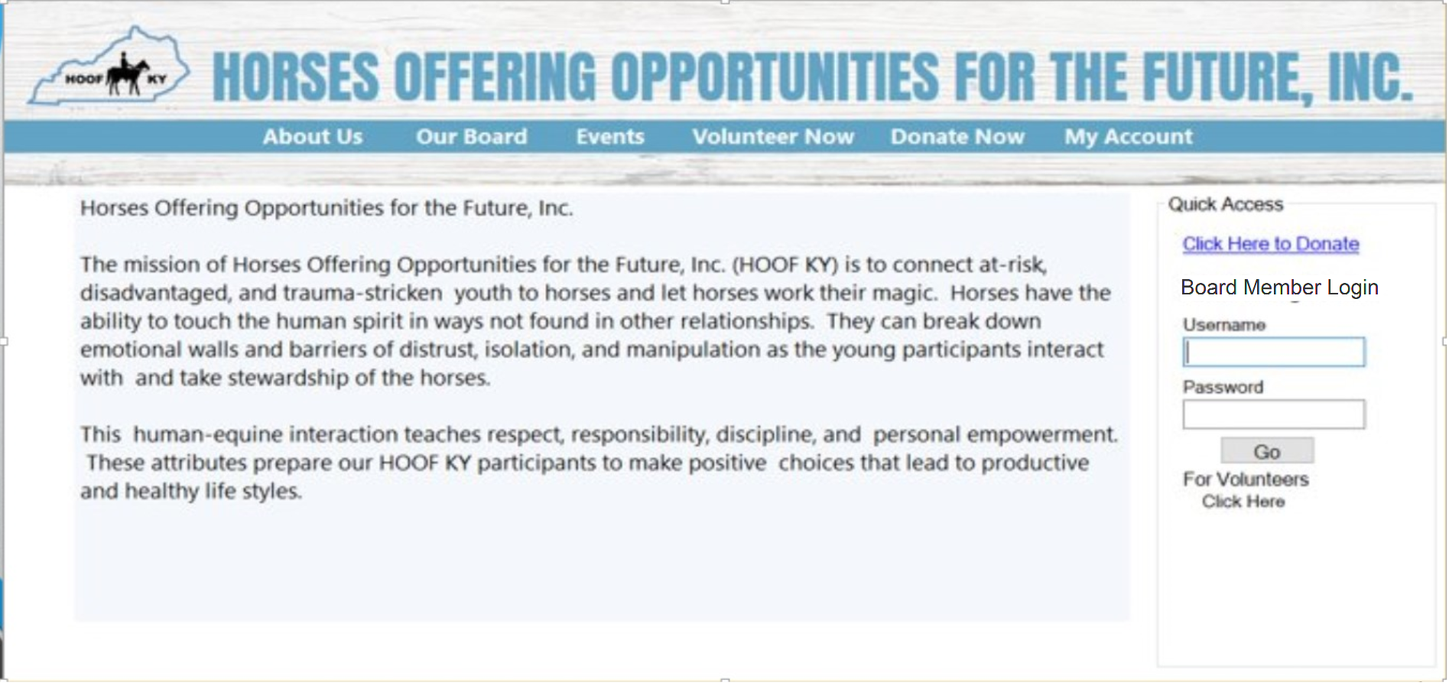
Board Member Login

Slide 13
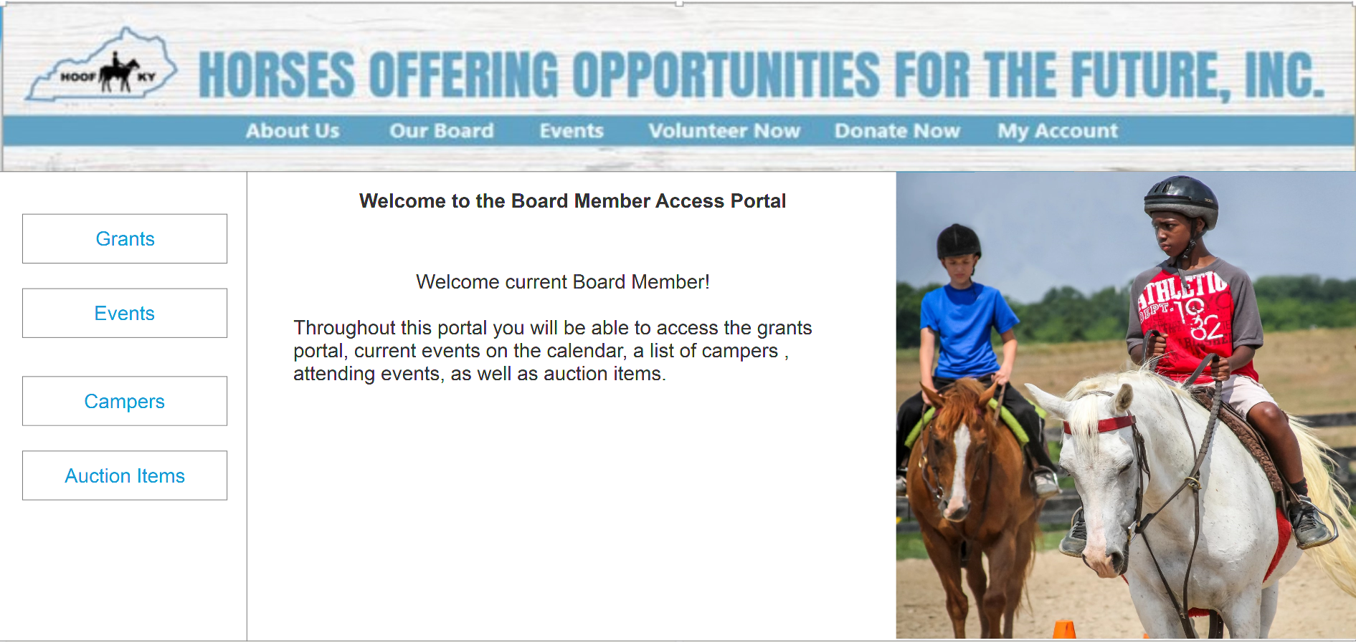
Board Member Portal

Slide 14
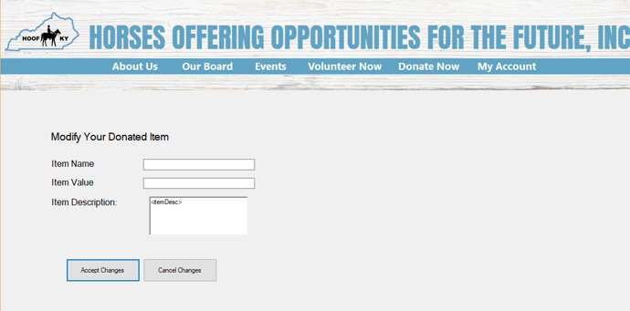
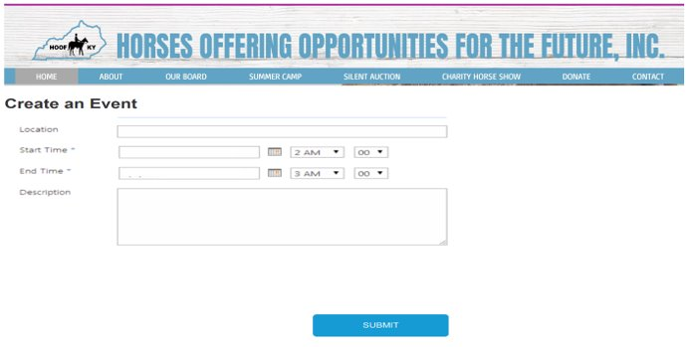
Examples of Past Board Member Prototypes

Slide 15
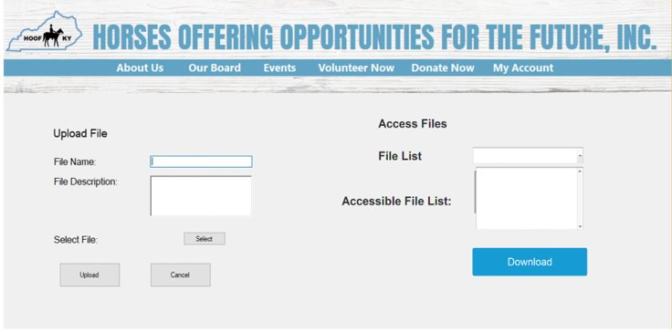
Examples of Past Board Member Prototypes Cont'd.

Slide 16

Data Backup Service Provider
Easiest and most simple to use online backup service
$4.95/month = 75GB online backup storage
$6.95/month = Unlimited backup storage
Supports all Operating Systems
Including mobile devices
Provides:
Data encryption
File versioning
File recovery

Slide 17
Conclusion
Overview of the Class Diagram
Described the relationships through a ERD
Provided an example of the Data Dictionary
Basic Walkthrough of the Windows Navigation Diagram
Example of Prototypes based off WND

